Slide 1
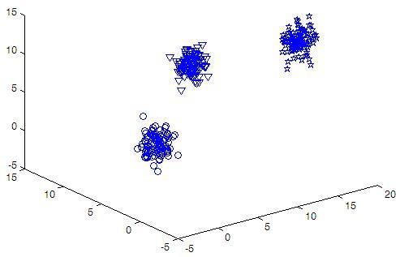
Sample Data for Sessional on
Bayesian Classification (Week2)

Slide 2
3 3 300
Feature1 Feature2 Feature3 Class
11.0306 9.0152 8.0199 1
11.4008 8.7768 6.7652 1
11.2489 9.5744 8.0812 1
9.3157 7.4360 5.6128 1
15.7777 1.5879 11.4440 2
15.8685 2.7902 11.2532 2
14.9448 0.7798 12.7481 2
15.9801 1.0142 14.2029 2
2.3979 5.6525 2.7566 3
2.5103 6.3484 1.4272 3
1.3739 3.2679 1.2037 3
2.7527 4.6571 3.1138 3
-0.0195 4.5524 0.0118 3
Sample Data
for
Bayesian
Classification

Slide 3
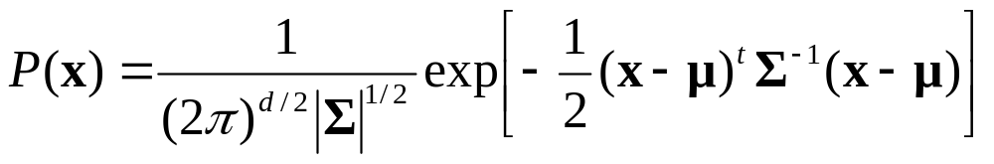
Assumption on Data Distribution
Assume multivariate density
  Multivariate normal density in d dimensions is:
where:
x = (x₁, x₂, …, x_{d})^{t} (t stands for the transpose vector form)
μ = (μ₁, μ₂, …, μ_{d})^{t} mean vector
Σ = d*d covariance matrix
|Σ| and Σ⁻¹ are determinant and inverse respectively

Slide 4
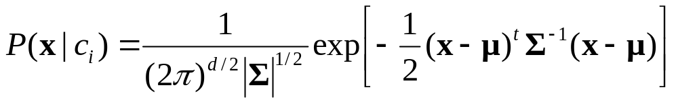
Algorithmic Steps
No. of features and classes will be variable
Use library functions to find μ, Σ , |Σ| and Σ⁻¹ from training data for each class
For a test sample x, find p(c_{i}|x) or p(c_{i})×p(x|c_{i}) for each class c_{i} where
Use different data files during evaluation

